Slide 1


Presentation of 2nd assignment - ece439
Dimitrios Tsalapatas
03246
Algorithm cad 2
29/05/2024

Slide 2
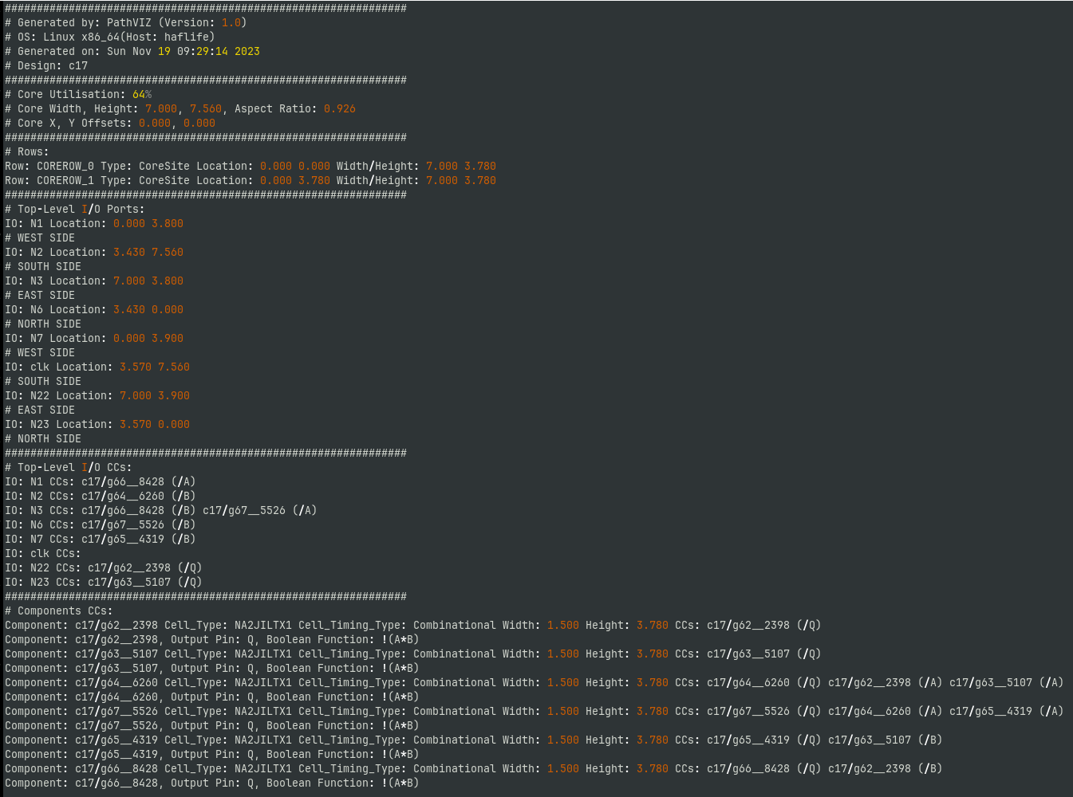
Concept
Example of practical format file
The main concept of HW_2 is to implement a parser for practical format files and draw components and connections on GUI.
Also, we need to store information about the design on hash tables.
After this we need to be able to print all necessary information using TCL command

Slide 3
Structs
There are three main hash tables:
Comphash: stores informations about each component
Gatepinhash: stores informations about each gatepin
Libhash: stores informations about each different cell
Each hashtable has a static HASHDEPTH that we define it as 20
If it has more than 20 collisions program prints error and exits

Slide 4
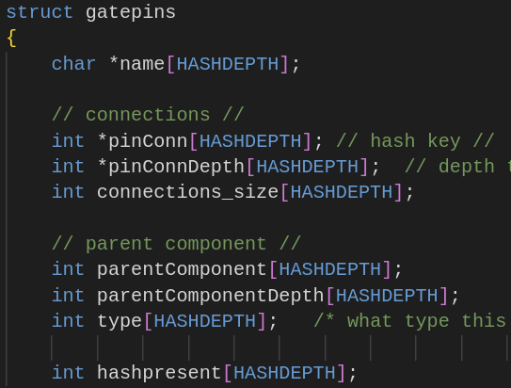
Gatepins Hashtable
gatepinhash:
Char *name[HASHDEPTH]: name of pin
Int *pinConn[HASHDEPTH]: array with hash values of successors of this pin
Int *pinConnDepth[HASHDEPTH]: array with hash depth of successors of this pin
Int connections_size[HASHDEPTH]: number of connections for each pin
Int parentComponent[HASHDEPTH]: hash value for component
Int parentComponentDepth[HASHDEPTH]: hash depth for component
Int type[HASHDEPTH]: Wire or IO
Int hashpresent[HASHDEPTH]: variable to show us if bucket is empty or not

Slide 5
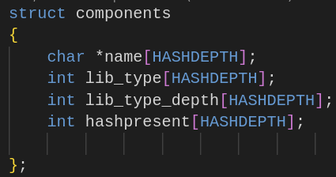
Components Hashtable
Comphash:
Char *name[HASHDEPTH]: name of component
Int lib_type[HASHDEPTH]: array with hash values of cell type
Int lib_type_depth[HASHDEPTH]: array with hash depth of cell type
Int hashpresent[HASHDEPTH]: variable to show us if bucket is empty or not

Slide 6
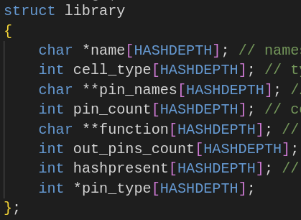
Library Hashtable
libhash:
Char *name[HASHDEPTH]: name of cell
Int cell_type[HASHDEPTH]: type of each cell (Combinational or Sequential)
Int *pin_names[HASHDEPTH]: names of pins for each cell
Int pin_count[HASHDEPTH]: number of pins current cell has
Char **function[HASHDEPTH]: boolean function for each cell (it can have more than one outputs)
Int out_pins_count[HASHDEPTH]: number of output pins
Int *pin_type[HASHDEPTH]: Input or Output
Int hashpresent[HASHDEPTH]: variable to show us if bucket is empty or not

Slide 7
Parser
I split the file in 3 parts:
1st one has the names of IOs
2nd has the connections of each IO
3rd one contains all components cells and gatepins connections
1
2
3

Slide 8
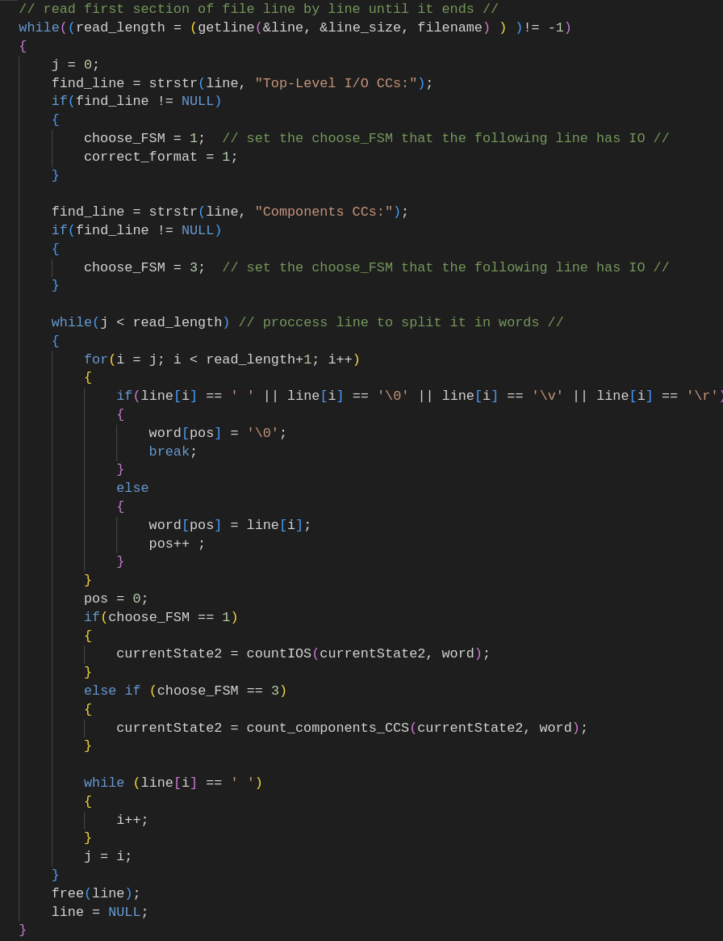
Parser
Parser reads file line by line and search for specific string that indicates a different part of file. Based on this sentence it chooses the corresponding FSM.
After this it splits the line into words and pass them to FSM

Slide 9
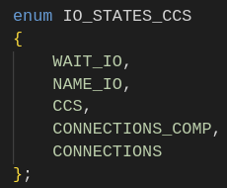
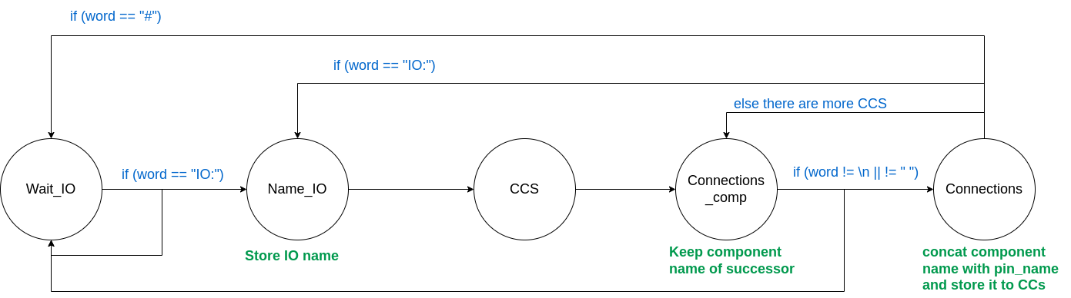
Parser
For all FSMs we use enums to be easier to read states
In first parse of file we count number of Components and Gateping we find to initialize the hashtables.
For cells we store them temporarily in a dynamic array and then find the exact number
Second parse: FSM that proccess IOS_CCs. It parses the 2nd part of file and store all IOs in gatepinhash and add all connections
Example: IO: o_wb_data|0 CCs: PID/U70 (/Q)
IO: o_un|31 CCs: PID/\un_reg[31] (/Q) PID/U830 (/IN0) PID/U1263 (/IN0)

Slide 10
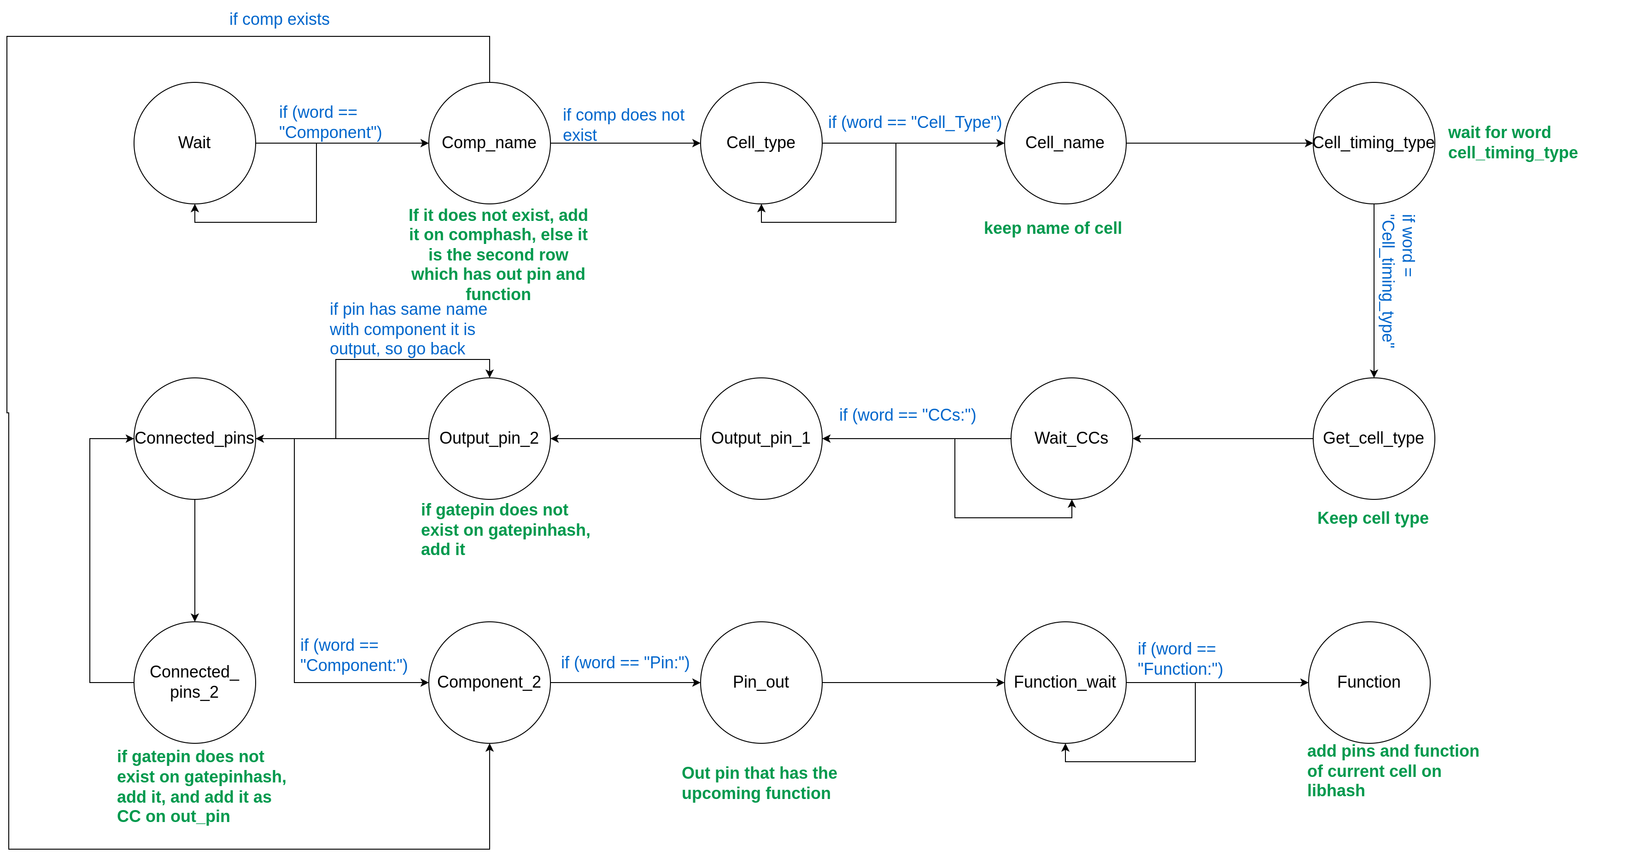
Second parse: FSM that proccess components cells and gatepins. It parses the 3rd part of file and store gatepins with connections, components with cell type and cells

Slide 11
Component: three_counters/U29 Cell_Type: add2d1 Cell_Timing_Type: Combinational Width: 15.120 Height: 8.400 CCs: three_counters/U29 (/CO) three_counters/U30 (/CI) three_counters/U29 (/SM) three_counters/U116 (/I1)
Component: three_counters/U29, Output Pin: CO, Boolean Function: (A*B)+(A*CI)+(B*CI)
Component: three_counters/U29, Output Pin: SM, Boolean Function: A^B^CI
Word: Component

Slide 12
Component: three_counters/U29 Cell_Type: add2d1 Cell_Timing_Type: Combinational Width: 15.120 Height: 8.400 CCs: three_counters/U29 (/CO) three_counters/U30 (/CI) three_counters/U29 (/SM) three_counters/U116 (/I1)
Component: three_counters/U29, Output Pin: CO, Boolean Function: (A*B)+(A*CI)+(B*CI)
Component: three_counters/U29, Output Pin: SM, Boolean Function: A^B^CI
Word: three_counters/U29
Comp_name

Slide 13
Component: three_counters/U29 Cell_Type: add2d1 Cell_Timing_Type: Combinational Width: 15.120 Height: 8.400 CCs: three_counters/U29 (/CO) three_counters/U30 (/CI) three_counters/U29 (/SM) three_counters/U116 (/I1)
Component: three_counters/U29, Output Pin: CO, Boolean Function: (A*B)+(A*CI)+(B*CI)
Component: three_counters/U29, Output Pin: SM, Boolean Function: A^B^CI
Word: Cell_Type
Comp_name

Slide 14
Component: three_counters/U29 Cell_Type: add2d1 Cell_Timing_Type: Combinational Width: 15.120 Height: 8.400 CCs: three_counters/U29 (/CO) three_counters/U30 (/CI) three_counters/U29 (/SM) three_counters/U116 (/I1)
Component: three_counters/U29, Output Pin: CO, Boolean Function: (A*B)+(A*CI)+(B*CI)
Component: three_counters/U29, Output Pin: SM, Boolean Function: A^B^CI
Word: add2d1
Comp_name
add2d1

Slide 15
Component: three_counters/U29 Cell_Type: add2d1 Cell_Timing_Type: Combinational Width: 15.120 Height: 8.400 CCs: three_counters/U29 (/CO) three_counters/U30 (/CI) three_counters/U29 (/SM) three_counters/U116 (/I1)
Component: three_counters/U29, Output Pin: CO, Boolean Function: (A*B)+(A*CI)+(B*CI)
Component: three_counters/U29, Output Pin: SM, Boolean Function: A^B^CI
Word: Cell_Timing_Type
Comp_name
add2d1

Slide 16
Component: three_counters/U29 Cell_Type: add2d1 Cell_Timing_Type: Combinational Width: 15.120 Height: 8.400 CCs: three_counters/U29 (/CO) three_counters/U30 (/CI) three_counters/U29 (/SM) three_counters/U116 (/I1)
Component: three_counters/U29, Output Pin: CO, Boolean Function: (A*B)+(A*CI)+(B*CI)
Component: three_counters/U29, Output Pin: SM, Boolean Function: A^B^CI
Word: Combinational
Comp_name
add2d1
Combinational

Slide 17
Component: three_counters/U29 Cell_Type: add2d1 Cell_Timing_Type: Combinational Width: 15.120 Height: 8.400 CCs: three_counters/U29 (/CO) three_counters/U30 (/CI) three_counters/U29 (/SM) three_counters/U116 (/I1)
Component: three_counters/U29, Output Pin: CO, Boolean Function: (A*B)+(A*CI)+(B*CI)
Component: three_counters/U29, Output Pin: SM, Boolean Function: A^B^CI
Word: Width
Comp_name
add2d1
Combinational

Slide 18
Component: three_counters/U29 Cell_Type: add2d1 Cell_Timing_Type: Combinational Width: 15.120 Height: 8.400 CCs: three_counters/U29 (/CO) three_counters/U30 (/CI) three_counters/U29 (/SM) three_counters/U116 (/I1)
Component: three_counters/U29, Output Pin: CO, Boolean Function: (A*B)+(A*CI)+(B*CI)
Component: three_counters/U29, Output Pin: SM, Boolean Function: A^B^CI
Word: CCs
Comp_name
add2d1
Combinational

Slide 19
Component: three_counters/U29 Cell_Type: add2d1 Cell_Timing_Type: Combinational Width: 15.120 Height: 8.400 CCs: three_counters/U29 (/CO) three_counters/U30 (/CI) three_counters/U29 (/SM) three_counters/U116 (/I1)
Component: three_counters/U29, Output Pin: CO, Boolean Function: (A*B)+(A*CI)+(B*CI)
Component: three_counters/U29, Output Pin: SM, Boolean Function: A^B^CI
Word: three_counters/U29
Comp_name
add2d1
Combinational
Three_counters/U29

Slide 20
Component: three_counters/U29 Cell_Type: add2d1 Cell_Timing_Type: Combinational Width: 15.120 Height: 8.400 CCs: three_counters/U29 (/CO) three_counters/U30 (/CI) three_counters/U29 (/SM) three_counters/U116 (/I1)
Component: three_counters/U29, Output Pin: CO, Boolean Function: (A*B)+(A*CI)+(B*CI)
Component: three_counters/U29, Output Pin: SM, Boolean Function: A^B^CI
Word: (/CO)
Comp_name
add2d1
Combinational
Three_counters/U29/CO

Slide 21

Component: three_counters/U29 Cell_Type: add2d1 Cell_Timing_Type: Combinational Width: 15.120 Height: 8.400 CCs: three_counters/U29 (/CO) three_counters/U30 (/CI) three_counters/U29 (/SM) three_counters/U116 (/I1)
Component: three_counters/U29, Output Pin: CO, Boolean Function: (A*B)+(A*CI)+(B*CI)
Component: three_counters/U29, Output Pin: SM, Boolean Function: A^B^CI
Word: (/CO)
Comp_name
add2d1
Combinational
Three_counters/U29/CO
Add gatepin to gatepinhash if it does not exists

Slide 22
Component: three_counters/U29 Cell_Type: add2d1 Cell_Timing_Type: Combinational Width: 15.120 Height: 8.400 CCs: three_counters/U29 (/CO) three_counters/U30 (/CI) three_counters/U29 (/SM) three_counters/U116 (/I1)
Component: three_counters/U29, Output Pin: CO, Boolean Function: (A*B)+(A*CI)+(B*CI)
Component: three_counters/U29, Output Pin: SM, Boolean Function: A^B^CI
Word: three_counters/U30
Comp_name
add2d1
Combinational
Three_counters/U29/CO
Three_counters/U30

Slide 23
Component: three_counters/U29 Cell_Type: add2d1 Cell_Timing_Type: Combinational Width: 15.120 Height: 8.400 CCs: three_counters/U29 (/CO) three_counters/U30 (/CI) three_counters/U29 (/SM) three_counters/U116 (/I1)
Component: three_counters/U29, Output Pin: CO, Boolean Function: (A*B)+(A*CI)+(B*CI)
Component: three_counters/U29, Output Pin: SM, Boolean Function: A^B^CI
Word: (/CI)
Comp_name
add2d1
Combinational
Three_counters/U29/CO
Three_counters/U30/CI

Slide 24
Component: three_counters/U29 Cell_Type: add2d1 Cell_Timing_Type: Combinational Width: 15.120 Height: 8.400 CCs: three_counters/U29 (/CO) three_counters/U30 (/CI) three_counters/U29 (/SM) three_counters/U116 (/I1)
Component: three_counters/U29, Output Pin: CO, Boolean Function: (A*B)+(A*CI)+(B*CI)
Component: three_counters/U29, Output Pin: SM, Boolean Function: A^B^CI
Word: (/CI)
Comp_name
add2d1
Combinational
Three_counters/U29/CO
Three_counters/U30/CI
Add gatepin to gatepinhash if it does not exists
Add gatepin to CCs of Three_counters/U29/CO

Slide 25
Component: three_counters/U29 Cell_Type: add2d1 Cell_Timing_Type: Combinational Width: 15.120 Height: 8.400 CCs: three_counters/U29 (/CO) three_counters/U30 (/CI) three_counters/U29 (/SM) three_counters/U116 (/I1)
Component: three_counters/U29, Output Pin: CO, Boolean Function: (A*B)+(A*CI)+(B*CI)
Component: three_counters/U29, Output Pin: SM, Boolean Function: A^B^CI
Word: three_counters/U29
Comp_name
add2d1
Combinational
Three_counters/U29/CO
Three_counters/U30/CI
Three_counters/U29

Slide 26
Component: three_counters/U29 Cell_Type: add2d1 Cell_Timing_Type: Combinational Width: 15.120 Height: 8.400 CCs: three_counters/U29 (/CO) three_counters/U30 (/CI) three_counters/U29 (/SM) three_counters/U116 (/I1)
Component: three_counters/U29, Output Pin: CO, Boolean Function: (A*B)+(A*CI)+(B*CI)
Component: three_counters/U29, Output Pin: SM, Boolean Function: A^B^CI
Word: (/SM)
Comp_name
add2d1
Combinational
Three_counters/U29/CO
Three_counters/U30/CI
Three_counters/U29/SM

Slide 27
Component: three_counters/U29 Cell_Type: add2d1 Cell_Timing_Type: Combinational Width: 15.120 Height: 8.400 CCs: three_counters/U29 (/CO) three_counters/U30 (/CI) three_counters/U29 (/SM) three_counters/U116 (/I1)
Component: three_counters/U29, Output Pin: CO, Boolean Function: (A*B)+(A*CI)+(B*CI)
Component: three_counters/U29, Output Pin: SM, Boolean Function: A^B^CI
Word: (/SM)
Comp_name
add2d1
Combinational
Three_counters/U29/CO
Three_counters/U30/CI
Three_counters/U29/SM
Add three_counters/U29/SM to gatepinhash if it does not exists

Slide 28
Component: three_counters/U29 Cell_Type: add2d1 Cell_Timing_Type: Combinational Width: 15.120 Height: 8.400 CCs: three_counters/U29 (/CO) three_counters/U30 (/CI) three_counters/U29 (/SM) three_counters/U116 (/I1)
Component: three_counters/U29, Output Pin: CO, Boolean Function: (A*B)+(A*CI)+(B*CI)
Component: three_counters/U29, Output Pin: SM, Boolean Function: A^B^CI
Word: three_counters/U116
Comp_name
add2d1
Combinational
Three_counters/U29/CO
Three_counters/U30/CI
Three_counters/U29/SM
Three_counters/U116

Slide 29
Component: three_counters/U29 Cell_Type: add2d1 Cell_Timing_Type: Combinational Width: 15.120 Height: 8.400 CCs: three_counters/U29 (/CO) three_counters/U30 (/CI) three_counters/U29 (/SM) three_counters/U116 (/I1)
Component: three_counters/U29, Output Pin: CO, Boolean Function: (A*B)+(A*CI)+(B*CI)
Component: three_counters/U29, Output Pin: SM, Boolean Function: A^B^CI
Word: (/I1)
Comp_name
add2d1
Combinational
Three_counters/U29/CO
Three_counters/U30/CI
Three_counters/U29/SM
Three_counters/U116/I1
Add gatepin to gatepinhash if it does not exists
Add gatepin to CCs of Three_counters/U29/SM

Slide 30
Component: three_counters/U29 Cell_Type: add2d1 Cell_Timing_Type: Combinational Width: 15.120 Height: 8.400 CCs: three_counters/U29 (/CO) three_counters/U30 (/CI) three_counters/U29 (/SM) three_counters/U116 (/I1)
Component: three_counters/U29, Output Pin: CO, Boolean Function: (A*B)+(A*CI)+(B*CI)
Component: three_counters/U29, Output Pin: SM, Boolean Function: A^B^CI
Word: Component
Comp_name
add2d1
Combinational
Three_counters/U29/CO
Three_counters/U30/CI
Three_counters/U29/SM
Three_counters/U116/I1

Slide 31
Component: three_counters/U29 Cell_Type: add2d1 Cell_Timing_Type: Combinational Width: 15.120 Height: 8.400 CCs: three_counters/U29 (/CO) three_counters/U30 (/CI) three_counters/U29 (/SM) three_counters/U116 (/I1)
Component: three_counters/U29, Output Pin: CO, Boolean Function: (A*B)+(A*CI)+(B*CI)
Component: three_counters/U29, Output Pin: SM, Boolean Function: A^B^CI
Word: three_counters/U29,
Comp_name
add2d1
Combinational
Three_counters/U29/CO
Three_counters/U30/CI
Three_counters/U29/SM
Three_counters/U116/I1

Slide 32
Component: three_counters/U29 Cell_Type: add2d1 Cell_Timing_Type: Combinational Width: 15.120 Height: 8.400 CCs: three_counters/U29 (/CO) three_counters/U30 (/CI) three_counters/U29 (/SM) three_counters/U116 (/I1)
Component: three_counters/U29, Output Pin: CO, Boolean Function: (A*B)+(A*CI)+(B*CI)
Component: three_counters/U29, Output Pin: SM, Boolean Function: A^B^CI
Word: Output
Comp_name
add2d1
Combinational
Three_counters/U29/CO
Three_counters/U30/CI
Three_counters/U29/SM
Three_counters/U116/I1

Slide 33
Component: three_counters/U29 Cell_Type: add2d1 Cell_Timing_Type: Combinational Width: 15.120 Height: 8.400 CCs: three_counters/U29 (/CO) three_counters/U30 (/CI) three_counters/U29 (/SM) three_counters/U116 (/I1)
Component: three_counters/U29, Output Pin: CO, Boolean Function: (A*B)+(A*CI)+(B*CI)
Component: three_counters/U29, Output Pin: SM, Boolean Function: A^B^CI
Word: Pin:
Comp_name
add2d1
Combinational
Three_counters/U29/CO
Three_counters/U30/CI
Three_counters/U29/SM
Three_counters/U116/I1

Slide 34
Component: three_counters/U29 Cell_Type: add2d1 Cell_Timing_Type: Combinational Width: 15.120 Height: 8.400 CCs: three_counters/U29 (/CO) three_counters/U30 (/CI) three_counters/U29 (/SM) three_counters/U116 (/I1)
Component: three_counters/U29, Output Pin: CO, Boolean Function: (A*B)+(A*CI)+(B*CI)
Component: three_counters/U29, Output Pin: SM, Boolean Function: A^B^CI
Word: CO,
Comp_name
add2d1
Combinational
Three_counters/U29/CO
Three_counters/U30/CI
Three_counters/U29/SM
Three_counters/U116/I1
Cell_pin

Slide 35
Component: three_counters/U29 Cell_Type: add2d1 Cell_Timing_Type: Combinational Width: 15.120 Height: 8.400 CCs: three_counters/U29 (/CO) three_counters/U30 (/CI) three_counters/U29 (/SM) three_counters/U116 (/I1)
Component: three_counters/U29, Output Pin: CO, Boolean Function: (A*B)+(A*CI)+(B*CI)
Component: three_counters/U29, Output Pin: SM, Boolean Function: A^B^CI
Word: Boolean
Comp_name
add2d1
Combinational
Three_counters/U29/CO
Three_counters/U30/CI
Three_counters/U29/SM
Three_counters/U116/I1
Cell_pin

Slide 36
Component: three_counters/U29 Cell_Type: add2d1 Cell_Timing_Type: Combinational Width: 15.120 Height: 8.400 CCs: three_counters/U29 (/CO) three_counters/U30 (/CI) three_counters/U29 (/SM) three_counters/U116 (/I1)
Component: three_counters/U29, Output Pin: CO, Boolean Function: (A*B)+(A*CI)+(B*CI)
Component: three_counters/U29, Output Pin: SM, Boolean Function: A^B^CI
Word: Function
Comp_name
add2d1
Combinational
Three_counters/U29/CO
Three_counters/U30/CI
Three_counters/U29/SM
Three_counters/U116/I1
Cell_pin

Slide 37
Component: three_counters/U29 Cell_Type: add2d1 Cell_Timing_Type: Combinational Width: 15.120 Height: 8.400 CCs: three_counters/U29 (/CO) three_counters/U30 (/CI) three_counters/U29 (/SM) three_counters/U116 (/I1)
Component: three_counters/U29, Output Pin: CO, Boolean Function: (A*B)+(A*CI)+(B*CI)
Component: three_counters/U29, Output Pin: SM, Boolean Function: A^B^CI
Word: (A*B)+(A*CI)+(B*CI)
Comp_name
add2d1
Combinational
Three_counters/U29/CO
Three_counters/U30/CI
Three_counters/U29/SM
Three_counters/U116/I1
Cell_pin
(A*B)+(A*CI)+(B*CI)

Slide 38
Component: three_counters/U29 Cell_Type: add2d1 Cell_Timing_Type: Combinational Width: 15.120 Height: 8.400 CCs: three_counters/U29 (/CO) three_counters/U30 (/CI) three_counters/U29 (/SM) three_counters/U116 (/I1)
Component: three_counters/U29, Output Pin: CO, Boolean Function: (A*B)+(A*CI)+(B*CI)
Component: three_counters/U29, Output Pin: SM, Boolean Function: A^B^CI
Word: (A*B)+(A*CI)+(B*CI)
Comp_name
add2d1
Combinational
Three_counters/U29/CO
Three_counters/U30/CI
Three_counters/U29/SM
Three_counters/U116/I1
Cell_pin
(A*B)+(A*CI)+(B*CI)
Add on hashtables component and cell with all information

Slide 39
Component: three_counters/U29 Cell_Type: add2d1 Cell_Timing_Type: Combinational Width: 15.120 Height: 8.400 CCs: three_counters/U29 (/CO) three_counters/U30 (/CI) three_counters/U29 (/SM) three_counters/U116 (/I1)
Component: three_counters/U29, Output Pin: CO, Boolean Function: (A*B)+(A*CI)+(B*CI)
Component: three_counters/U29, Output Pin: SM, Boolean Function: A^B^CI
Word: Component:
Comp_name
add2d1
Combinational
Three_counters/U29/CO
Three_counters/U30/CI
Three_counters/U29/SM
Three_counters/U116/I1
Cell_pin
(A*B)+(A*CI)+(B*CI)

Slide 40
Component: three_counters/U29 Cell_Type: add2d1 Cell_Timing_Type: Combinational Width: 15.120 Height: 8.400 CCs: three_counters/U29 (/CO) three_counters/U30 (/CI) three_counters/U29 (/SM) three_counters/U116 (/I1)
Component: three_counters/U29, Output Pin: CO, Boolean Function: (A*B)+(A*CI)+(B*CI)
Component: three_counters/U29, Output Pin: SM, Boolean Function: A^B^CI
Word: three_counters/U29,
Already exists
Comp_name
add2d1
Combinational
Three_counters/U29/CO
Three_counters/U30/CI
Three_counters/U29/SM
Three_counters/U116/I1
Cell_pin
(A*B)+(A*CI)+(B*CI)

Slide 41
Component: three_counters/U29 Cell_Type: add2d1 Cell_Timing_Type: Combinational Width: 15.120 Height: 8.400 CCs: three_counters/U29 (/CO) three_counters/U30 (/CI) three_counters/U29 (/SM) three_counters/U116 (/I1)
Component: three_counters/U29, Output Pin: CO, Boolean Function: (A*B)+(A*CI)+(B*CI)
Component: three_counters/U29, Output Pin: SM, Boolean Function: A^B^CI
Word: Output
Comp_name
add2d1
Combinational
Three_counters/U29/CO
Three_counters/U30/CI
Three_counters/U29/SM
Three_counters/U116/I1
Cell_pin
(A*B)+(A*CI)+(B*CI)

Slide 42
Component: three_counters/U29 Cell_Type: add2d1 Cell_Timing_Type: Combinational Width: 15.120 Height: 8.400 CCs: three_counters/U29 (/CO) three_counters/U30 (/CI) three_counters/U29 (/SM) three_counters/U116 (/I1)
Component: three_counters/U29, Output Pin: CO, Boolean Function: (A*B)+(A*CI)+(B*CI)
Component: three_counters/U29, Output Pin: SM, Boolean Function: A^B^CI
Word: Pin:
Comp_name
add2d1
Combinational
Three_counters/U29/CO
Three_counters/U30/CI
Three_counters/U29/SM
Three_counters/U116/I1
Cell_pin
(A*B)+(A*CI)+(B*CI)

Slide 43
Component: three_counters/U29 Cell_Type: add2d1 Cell_Timing_Type: Combinational Width: 15.120 Height: 8.400 CCs: three_counters/U29 (/CO) three_counters/U30 (/CI) three_counters/U29 (/SM) three_counters/U116 (/I1)
Component: three_counters/U29, Output Pin: CO, Boolean Function: (A*B)+(A*CI)+(B*CI)
Component: three_counters/U29, Output Pin: SM, Boolean Function: A^B^CI
Word: SM,
Comp_name
add2d1
Combinational
Three_counters/U29/CO
Three_counters/U30/CI
Three_counters/U29/SM
Three_counters/U116/I1
Cell_pin (SM)
(A*B)+(A*CI)+(B*CI)

Slide 44
Component: three_counters/U29 Cell_Type: add2d1 Cell_Timing_Type: Combinational Width: 15.120 Height: 8.400 CCs: three_counters/U29 (/CO) three_counters/U30 (/CI) three_counters/U29 (/SM) three_counters/U116 (/I1)
Component: three_counters/U29, Output Pin: CO, Boolean Function: (A*B)+(A*CI)+(B*CI)
Component: three_counters/U29, Output Pin: SM, Boolean Function: A^B^CI
Word: Function
Comp_name
add2d1
Combinational
Three_counters/U29/CO
Three_counters/U30/CI
Three_counters/U29/SM
Three_counters/U116/I1
Cell_pin (SM)
(A*B)+(A*CI)+(B*CI)

Slide 45
Component: three_counters/U29 Cell_Type: add2d1 Cell_Timing_Type: Combinational Width: 15.120 Height: 8.400 CCs: three_counters/U29 (/CO) three_counters/U30 (/CI) three_counters/U29 (/SM) three_counters/U116 (/I1)
Component: three_counters/U29, Output Pin: CO, Boolean Function: (A*B)+(A*CI)+(B*CI)
Component: three_counters/U29, Output Pin: SM, Boolean Function: A^B^CI
Word: A^B^CI
Comp_name
add2d1
Combinational
Three_counters/U29/CO
Three_counters/U30/CI
Three_counters/U29/SM
Three_counters/U116/I1
Cell_pin (SM)
A^B^CI

Slide 46
Component: three_counters/U29 Cell_Type: add2d1 Cell_Timing_Type: Combinational Width: 15.120 Height: 8.400 CCs: three_counters/U29 (/CO) three_counters/U30 (/CI) three_counters/U29 (/SM) three_counters/U116 (/I1)
Component: three_counters/U29, Output Pin: CO, Boolean Function: (A*B)+(A*CI)+(B*CI)
Component: three_counters/U29, Output Pin: SM, Boolean Function: A^B^CI
Word: A^B^CI
Comp_name
add2d1
Combinational
Three_counters/U29/CO
Three_counters/U30/CI
Three_counters/U29/SM
Three_counters/U116/I1
Cell_pin (SM)
A^B^CI
Add on hashtables cell with all informations

Slide 47
Component: three_counters/U29 Cell_Type: add2d1 Cell_Timing_Type: Combinational Width: 15.120 Height: 8.400 CCs: three_counters/U29 (/CO) three_counters/U30 (/CI) three_counters/U29 (/SM) three_counters/U116 (/I1)
Component: three_counters/U29, Output Pin: CO, Boolean Function: (A*B)+(A*CI)+(B*CI)
Component: three_counters/U29, Output Pin: SM, Boolean Function: A^B^CI
END
Comp_name
add2d1
Combinational
Three_counters/U29/CO
Three_counters/U30/CI
Three_counters/U29/SM
Three_counters/U116/I1
Cell_pin (SM)
A^B^CI

Slide 48
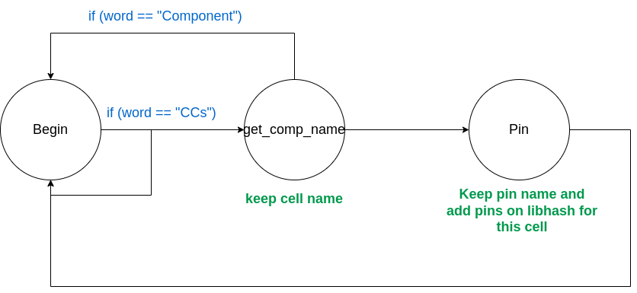
Third parse: FSM that proccess 3rd part of file and search on gatepins for pins (input pins) to add them in libhash for current cell if they are not already exists

Slide 49
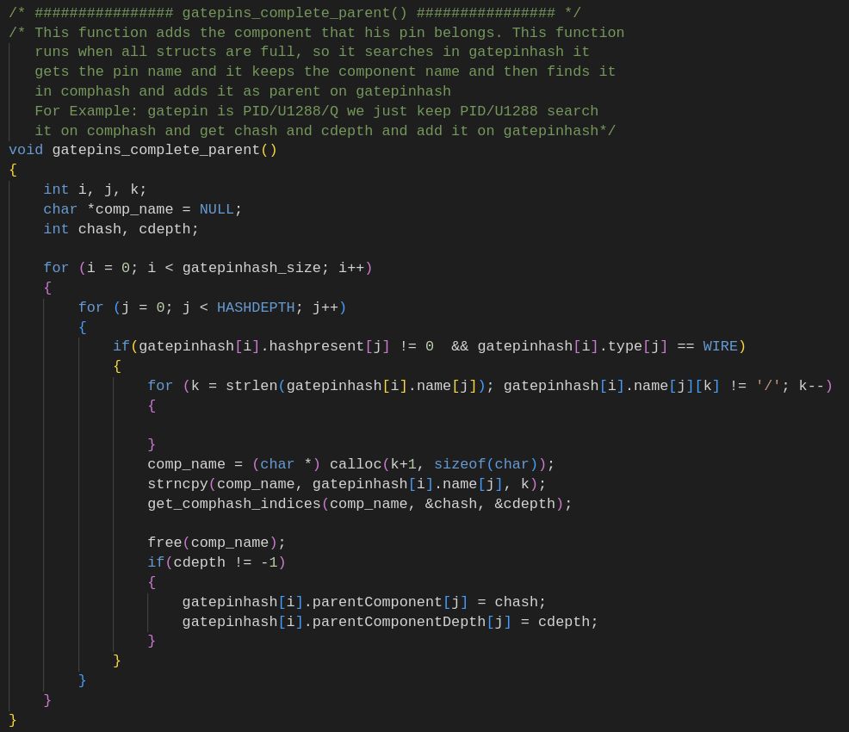
After Parsing
Now there are two fields that are empty:
On gatepinsh the field that specifies which component they belong
IOs type (if they are Input or Output)
We don't parse file again to fill these fields. We have already the hashtables with components and gatepins, so we take first part of gatepin name (which is component name) and we find hash and depth on comphash and pass them on gatepin
For IOs type, we get the from gatepinhash all IOs and check if first connection is Output or input. In case it has not connections we suppose that it is Input. In this way we fill this field.

Slide 50
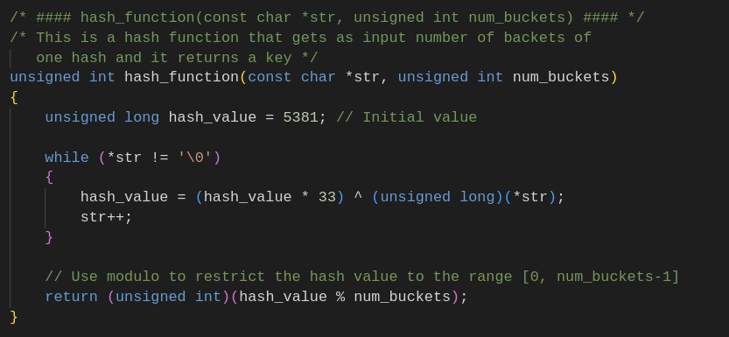
Hash Function
Hash Function that returns the position of bucket according to size of hash table

Slide 51
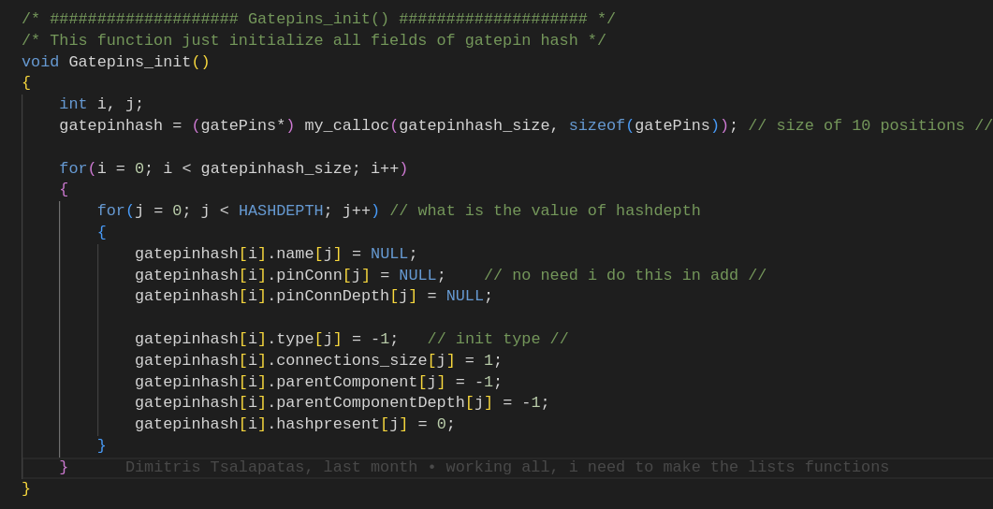
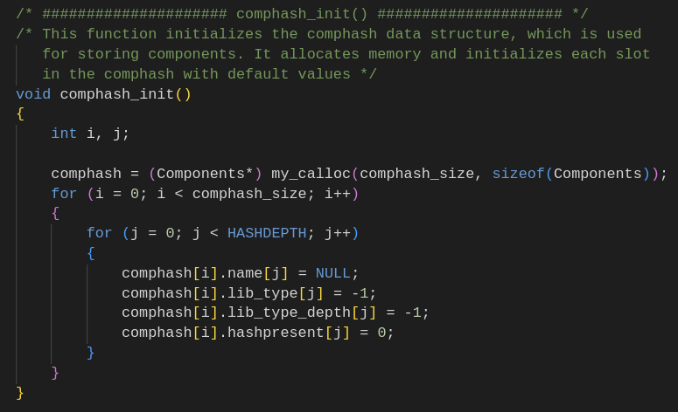
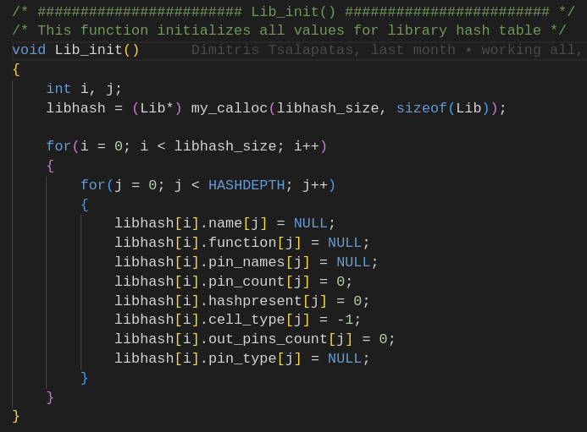
Structs Initialazation

Slide 52
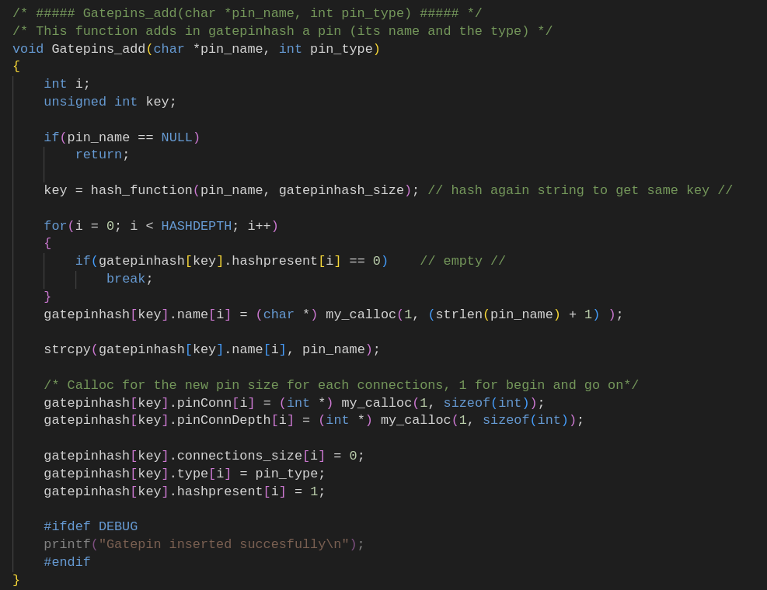
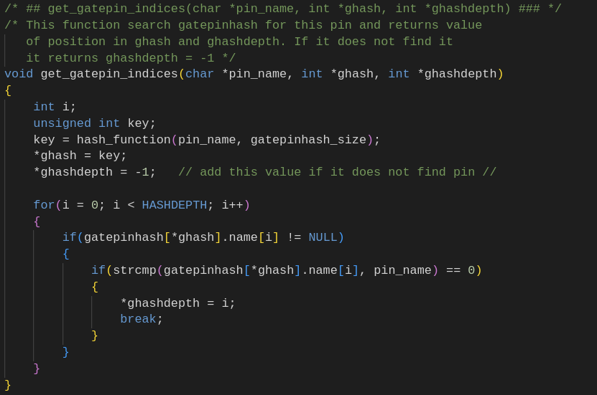
Functions for gatepinhash
Gatepins_add
Get_gatepin_indices

Slide 53
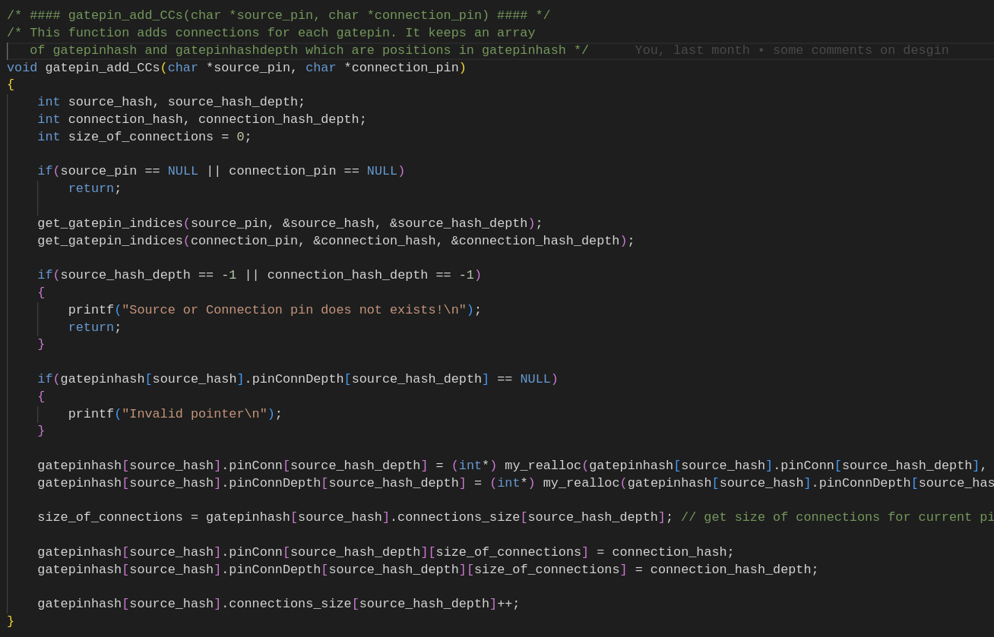
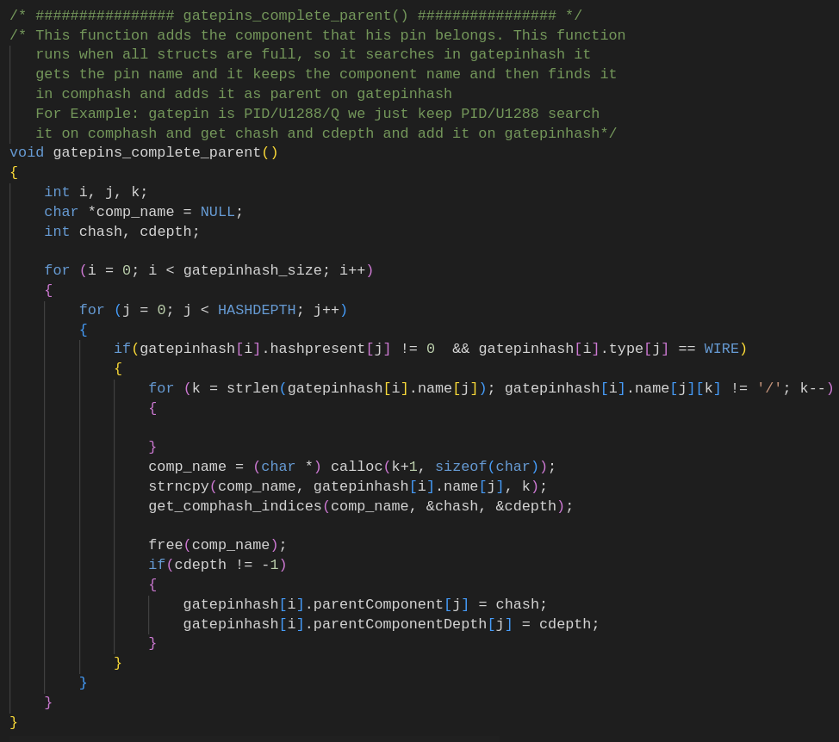
Functions for gatepinhash
gatepin_add_CCs
gatepins_complete_parent

Slide 54
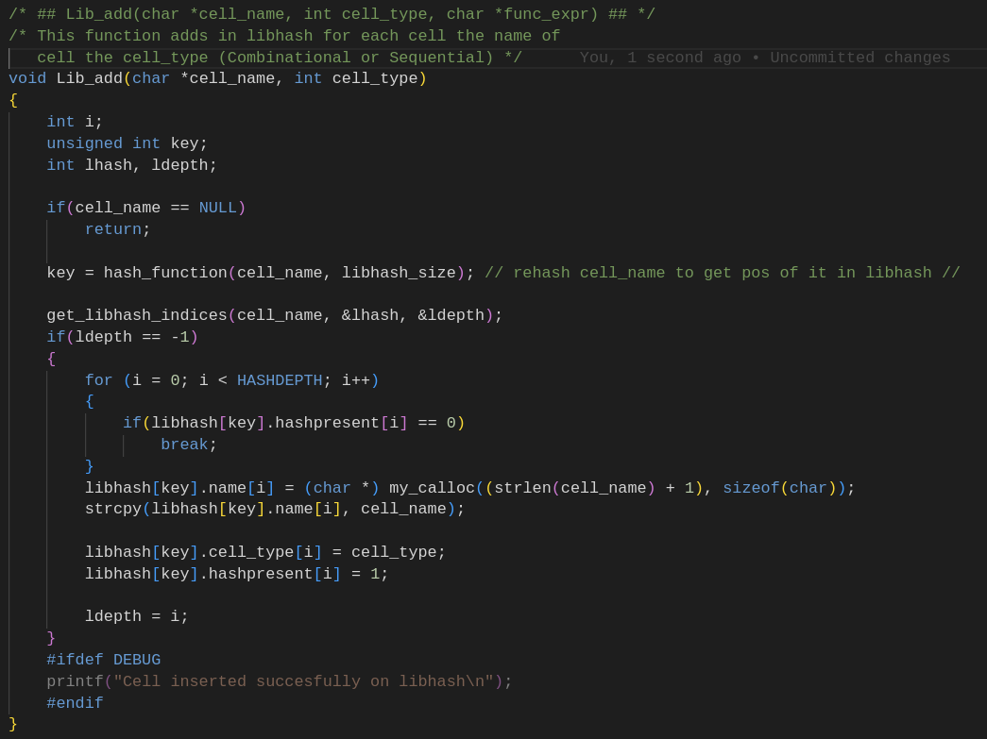
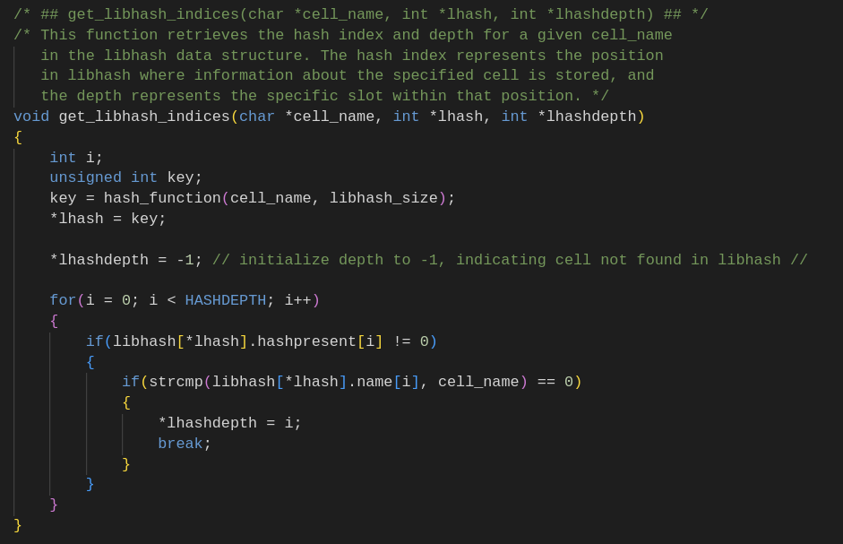
Functions for Libhash
Lib_add
get_libhash_indices

Slide 55
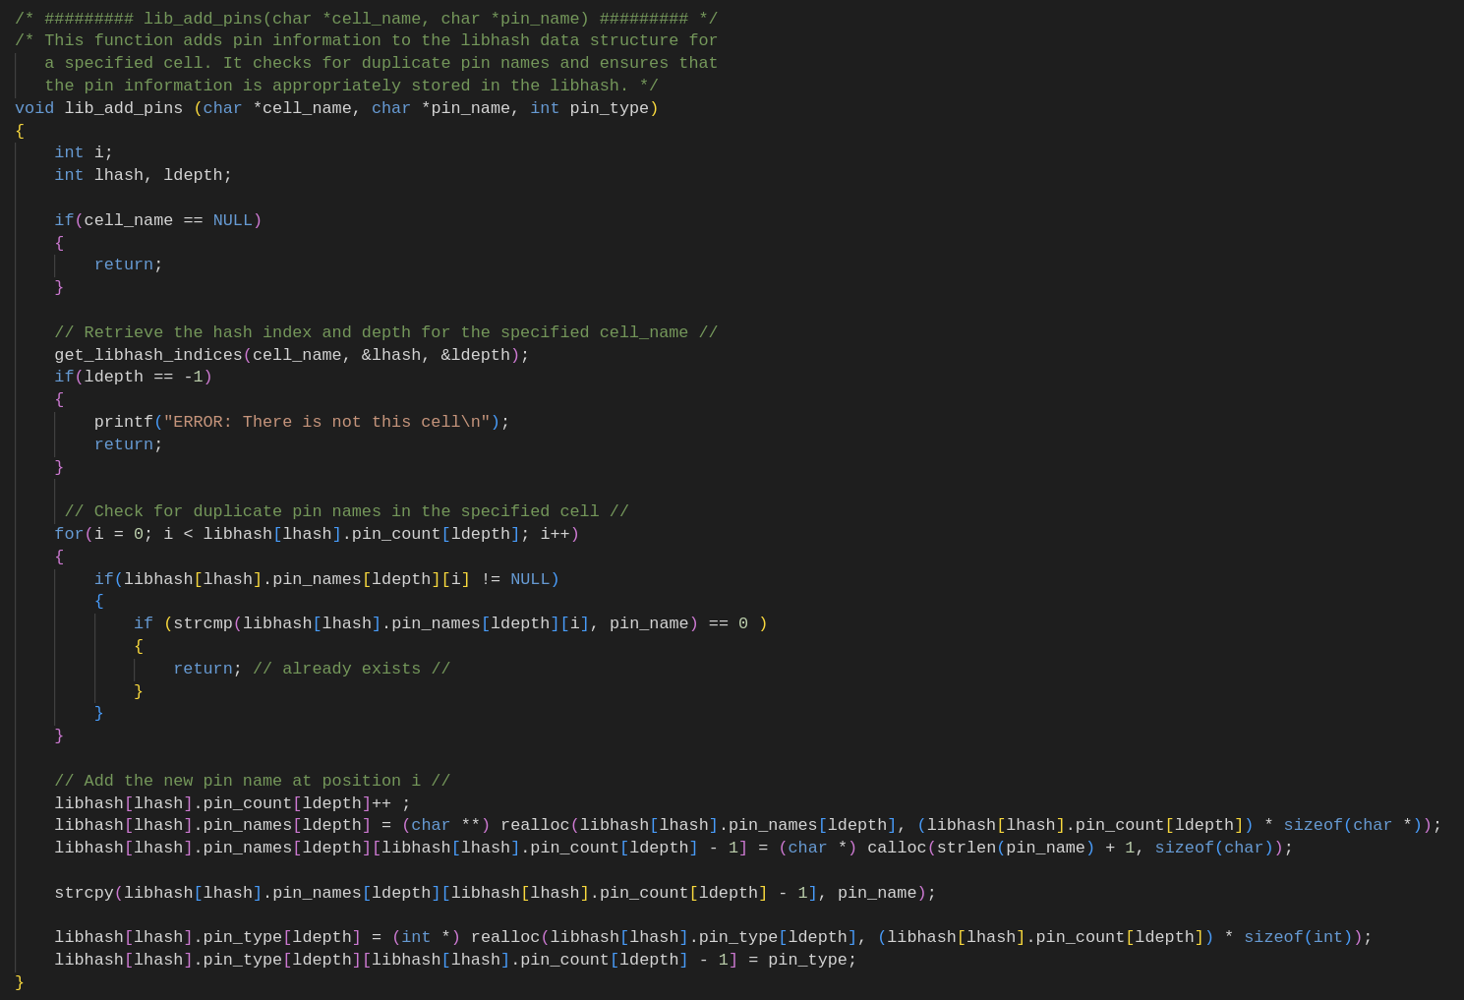
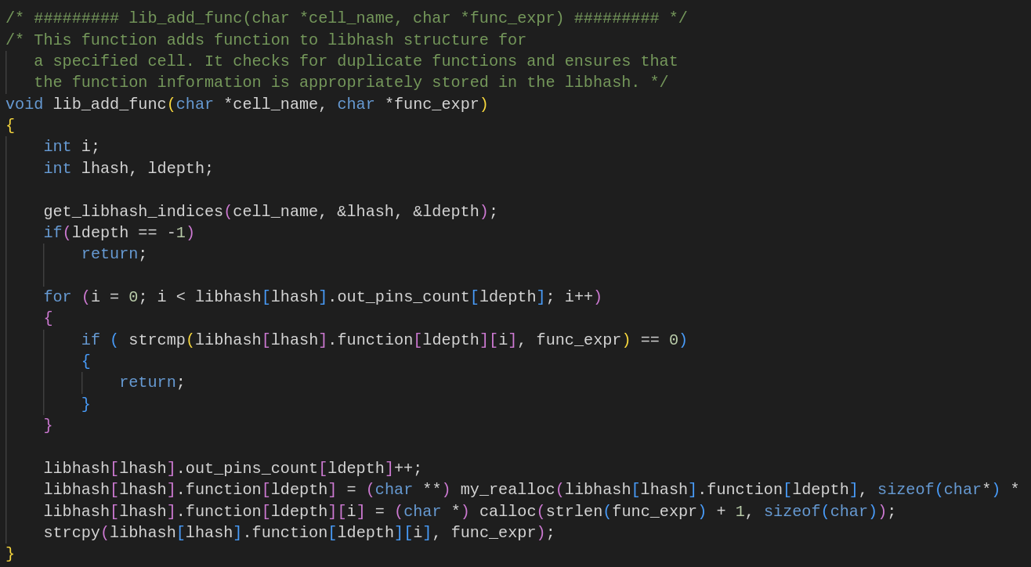
Functions for Libhash
Lib_add_pins
Lib_add_func

Slide 56
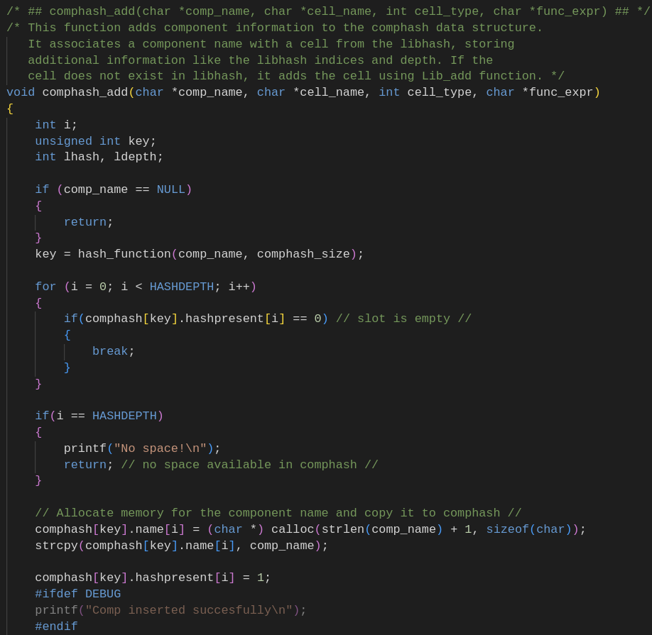
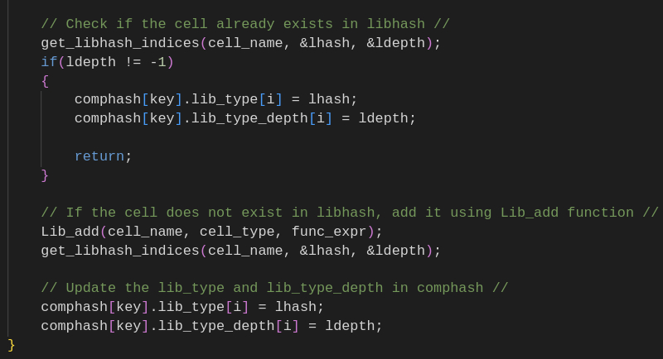
Functions for Comphash
Comphash_add

Slide 57
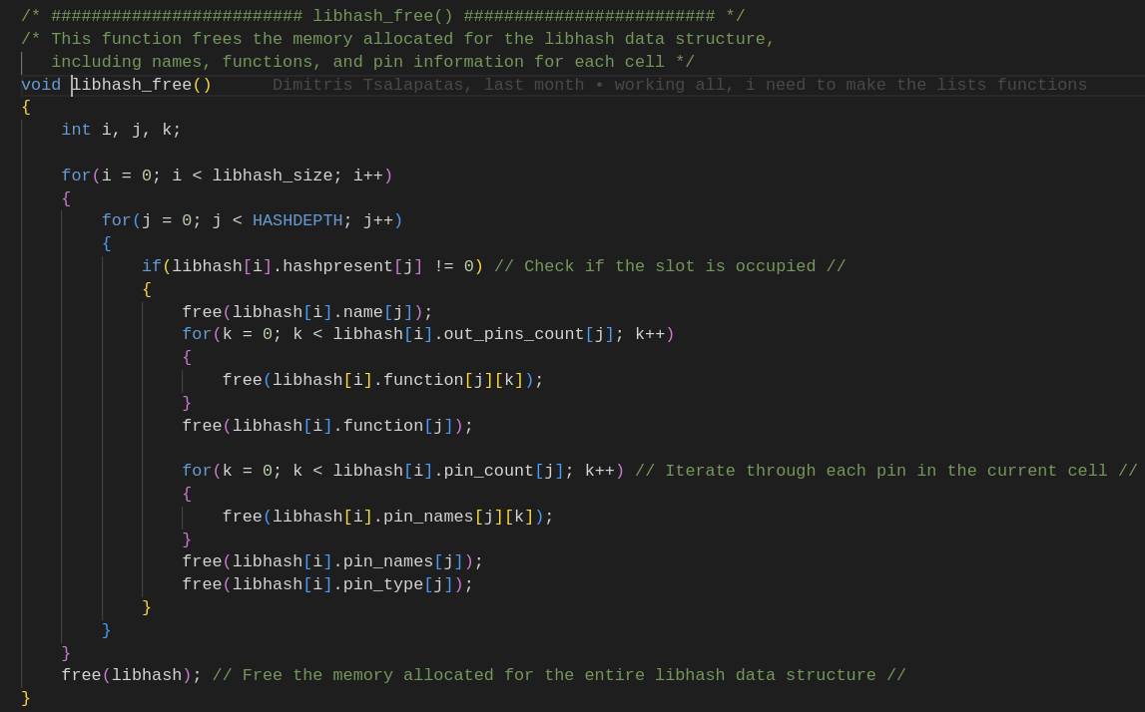
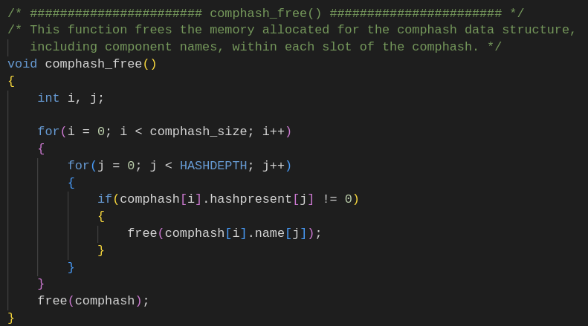
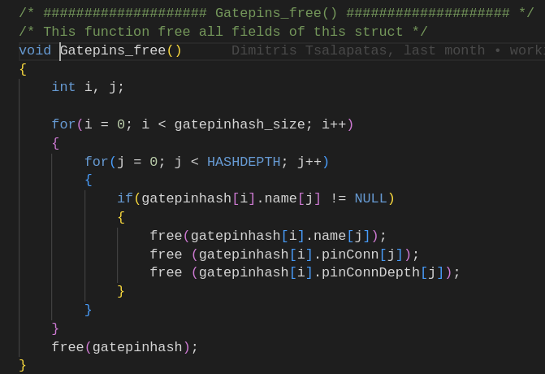
Structs Free

Slide 58
Supported TCL commands
Read_design: Read current file
List_IOs: List all IOs of design and their connections
List_components: print a TCL list with all components of design
Report_component_function: Print functions for each output pin of given component
Report_component_type: Print type of component (Combinational or Sequential)
List_component_CCS: Print connections of current component
List_IO_CCS: Print connections of current IO
List_cell: Print all fields of given cell
List_cells: Print all fields of all cells of design
List_component_info: Print cell type and connections of given component
List_components_info: Print cell type and connections of all components
Clear_design: Clear and free all structures

Slide 59
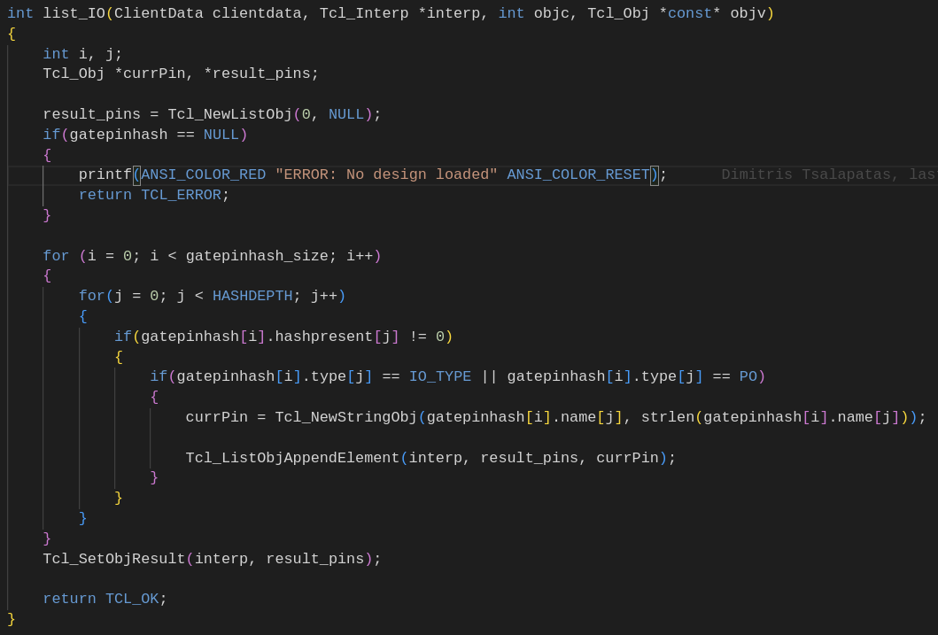
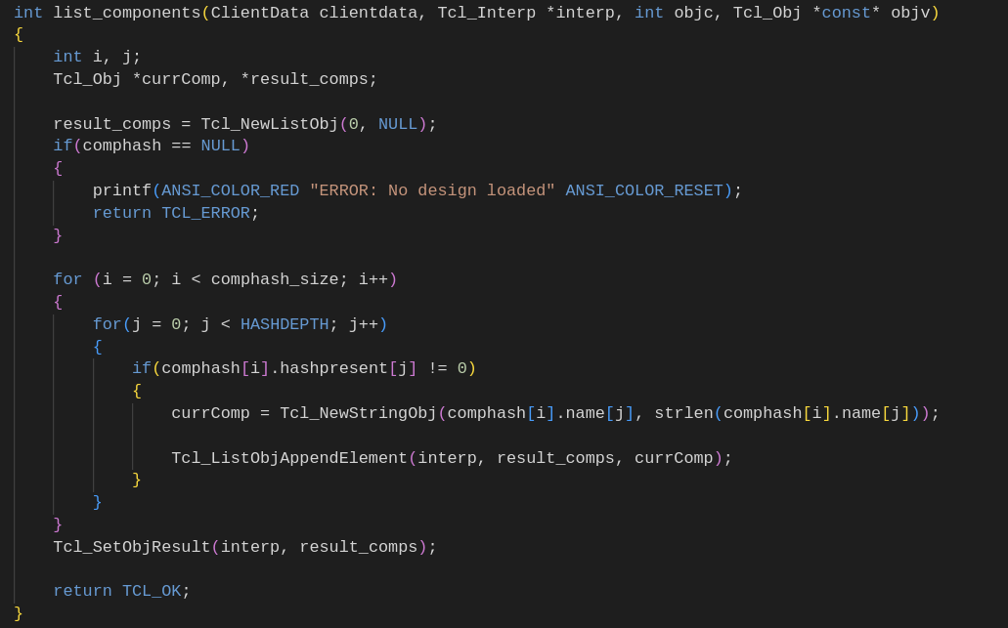
Some Examples

Slide 60
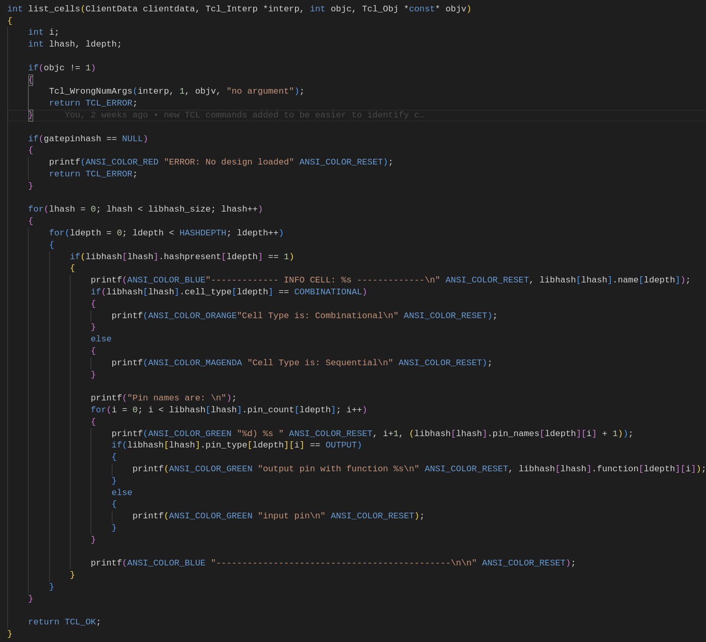
Some Examples

Slide 61
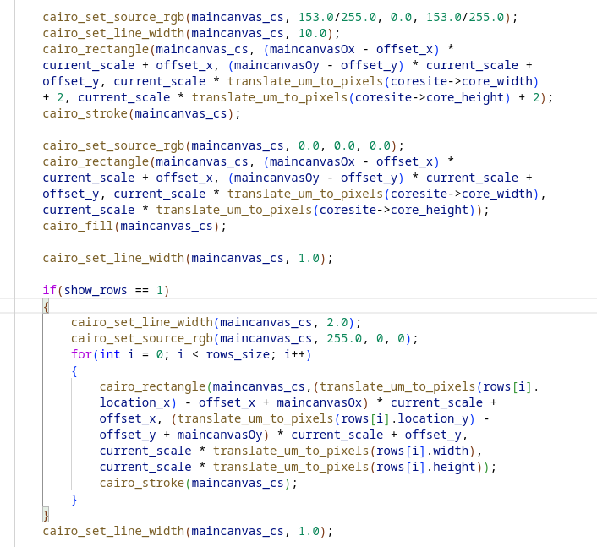
Draw coresite and Rows

Slide 62
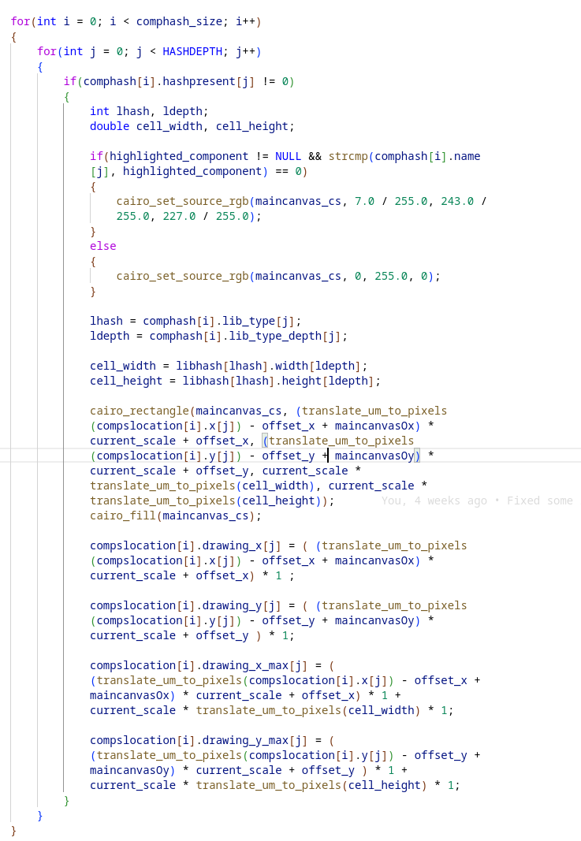
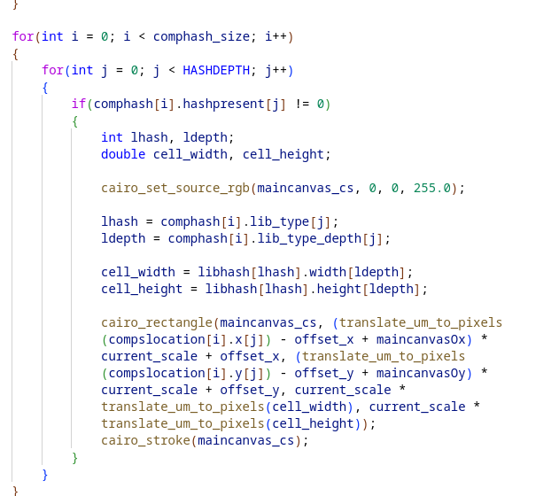
GUI Draw
Draw outline of components

Slide 63
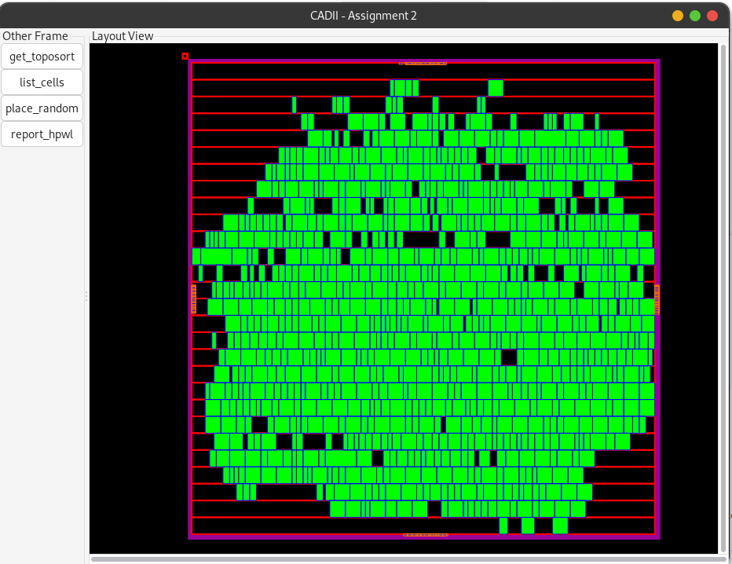
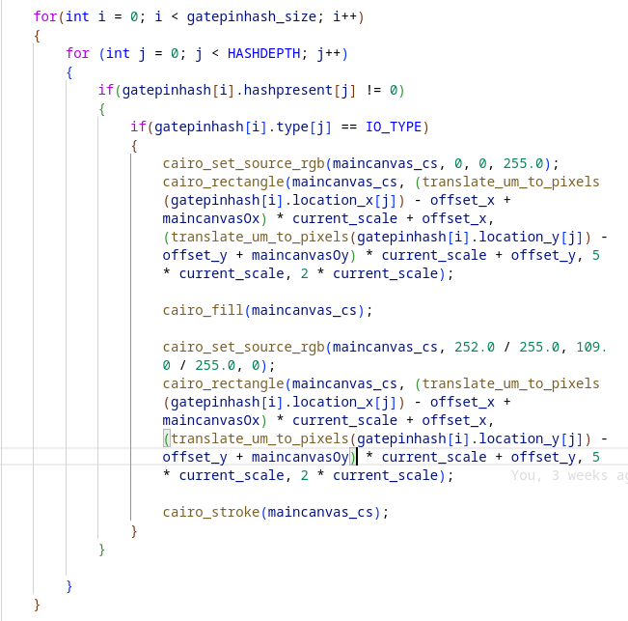
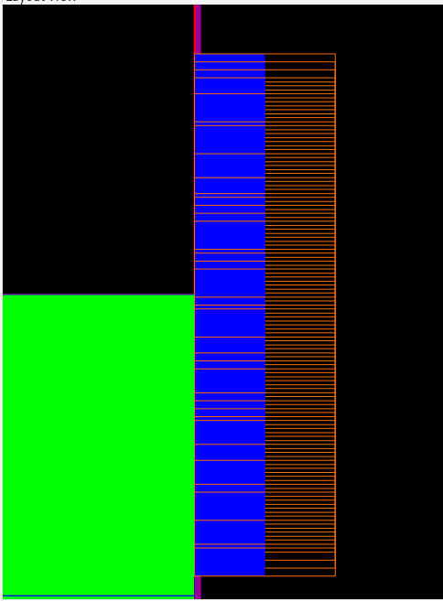
GUI Draw
Draw IOs

Slide 64
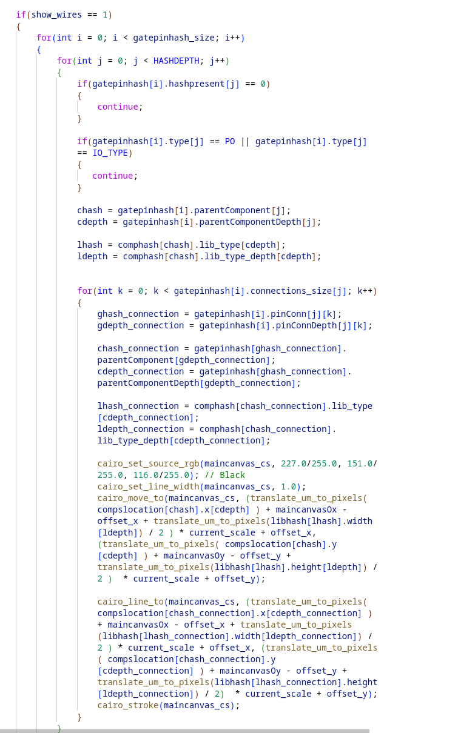
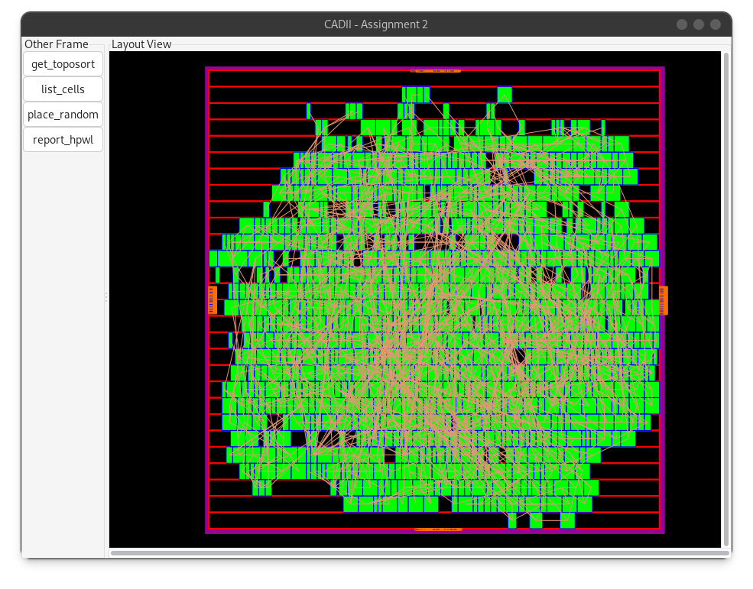
Internal Nets draw

Slide 65
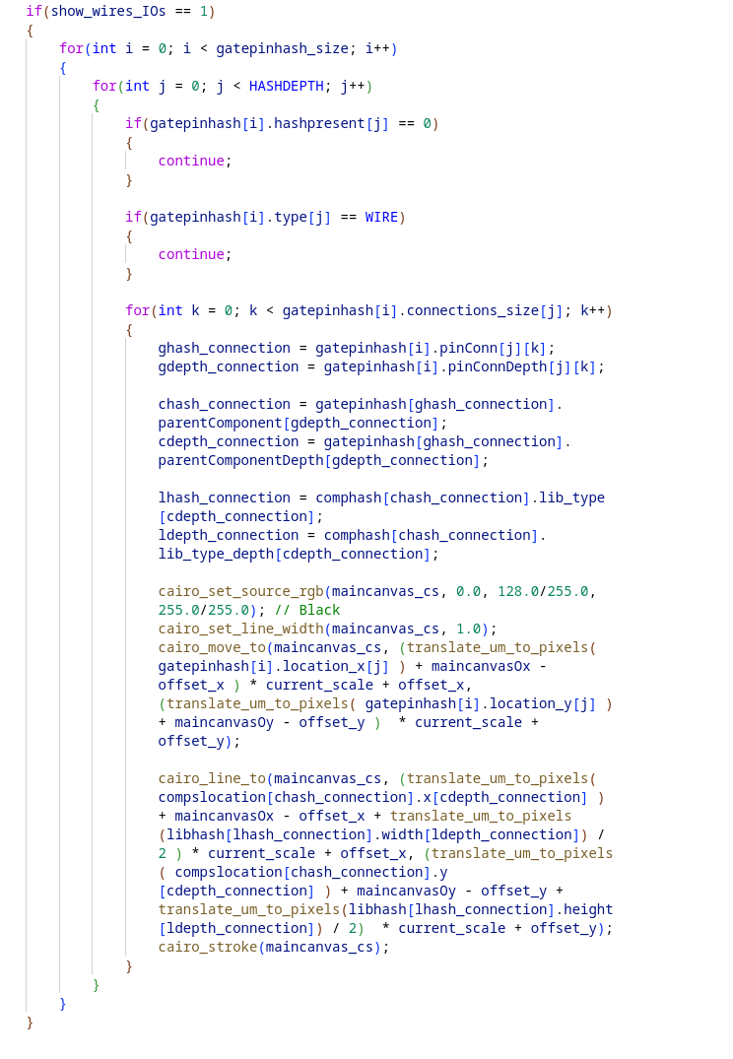
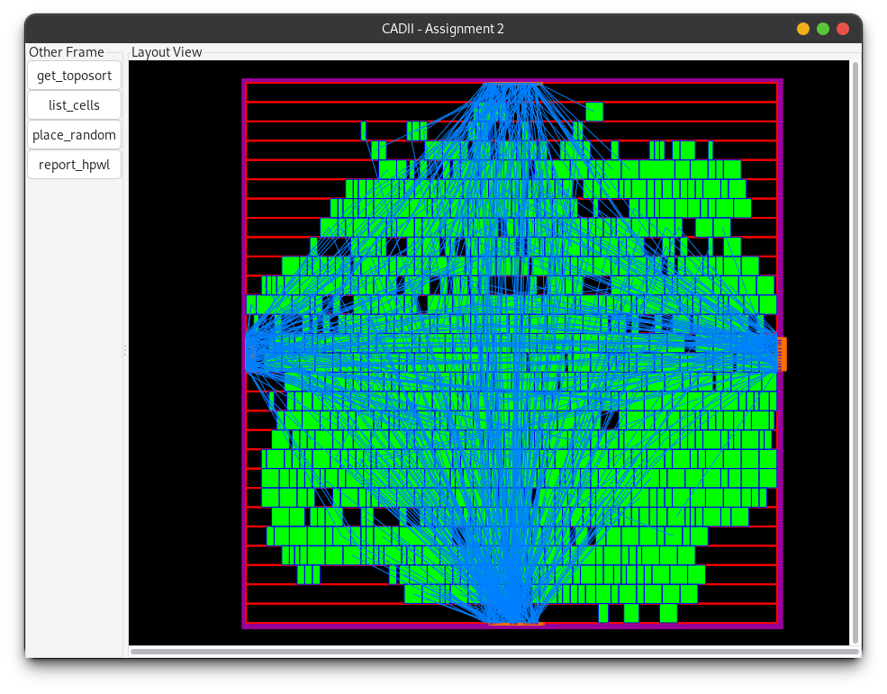
IOs connections draw

Slide 66
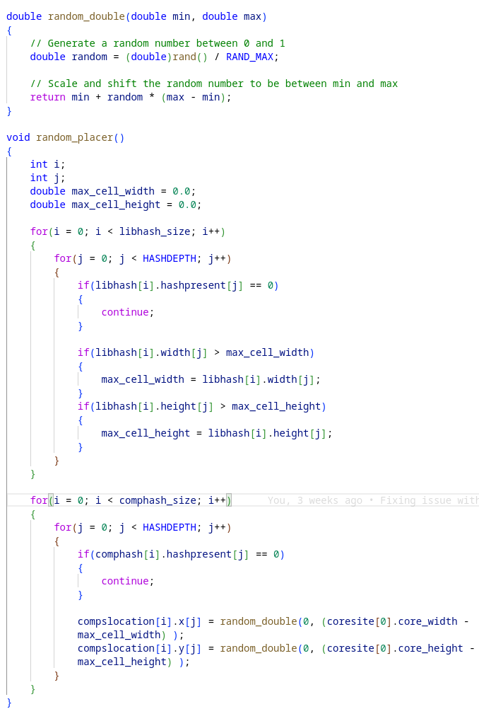
Random Placement
Take into consideration max height and width of cells

Slide 67
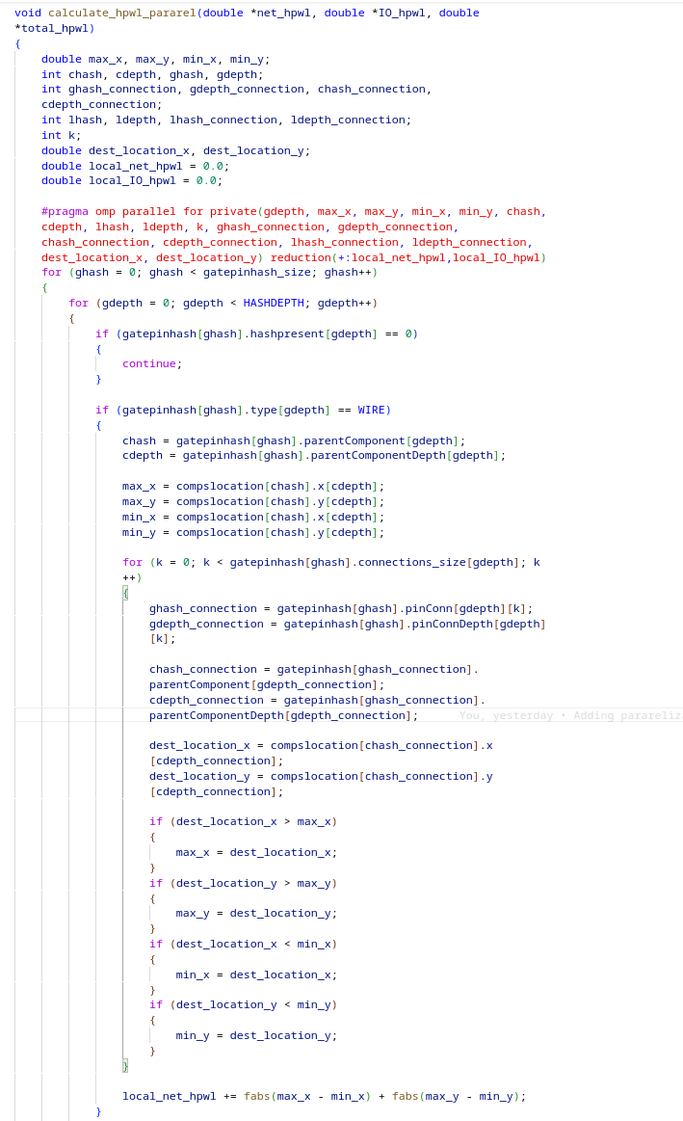
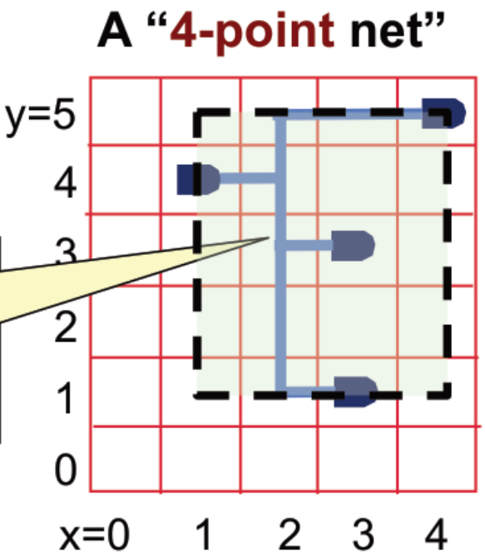
Report HPWL
Private: Define variables that should be private for each thread
Reduction: specifies that the variables local_net_hpwl and local_IO_hpwl should be combined across all threads at the end of the parallel region using the + operator.

Slide 68
Results HPWL

Slide 69
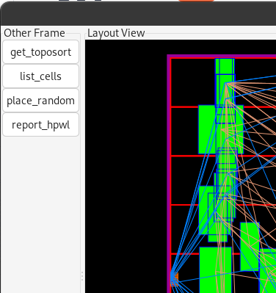
Extra Features
Show / hide Rows using shortcut ctrl + r
Show / hide Internal Nets using shortcut ctrl + w
Show / hide IOs wires using shortcut shift + w
Show / hide cells using shortcut shift + c
Some buttons to call functions from GUI
TCL command show_gui / hide_gui
Arument -hide_gui to initialise only TCL thread
Argument -f to load practicalformat

Slide 70
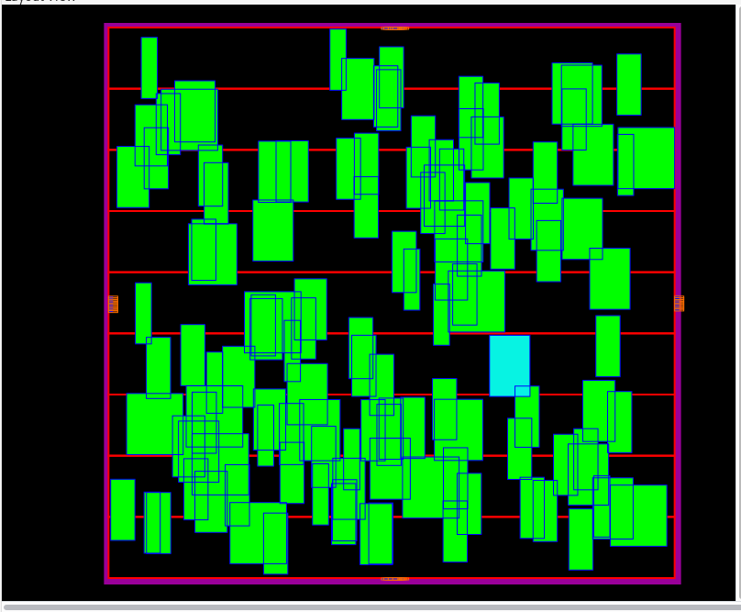
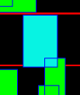
Highlight components
TCL command that user can specify one cell to highlight it
Click on one component and this cell changes color and prints all info about it on TCL shell

Slide 71

Thank you for your attention!
Do you have any questions?

